Slide 1
SMART GLOVES
Prepared by
Group Number: B3
Gunjan Das Chowdhury(University Roll Number: 34200318029)
Shubam Shaw(University Roll Number: 34200318013)
Lubdhak Modak(University Roll Number: 34200318025)
Harsh Prasad(University Roll Number: 34200318028)
Subject : Design Lab
Paper Code : EC681

Slide 2
CONTENTS:
Introduction
Purpose
Advantages
Use Case Diagram
Flow Chart of System
How it Works?
Limitation
Conclusion
Acknowledgement

Slide 3
INTRODUCTION:
Nowadays, technology and human life cannot be separated as it has become the phenomenon of the world. But, how the technology can help people that visually impaired?
Third eye for blinds is an innovation which helps the blinds people to navigate with speed and confidence by detecting the nearby obstacles using the help of ultrasonic waves and notify them with buzzer sound or vibration. They only need to wear this device as a band or cloth. The intensity of vibration and rate of beeping increases with decrease in distance and this is a fully automated device.

Slide 4
PURPOSE:
According to WHO 39 million peoples are estimated as blinds worldwide.
They are suffering a lot of harder ship in there daily life.
The features of Third eye for blind people: By wearing this device they can fully avoid the use of white cane and such other devices. This devices will help the blind to navigate without holding a stick which is a bit annoying for them. They can simply wear it as a band and it can function very accurately and they only need a very little training to use it.

Slide 5
ADVANTAGES:
Low design time.
Low production cost.
This system is applicable for both the indoor and outdoor environment.
It is dynamic system.
Less space.
Less power consumption.

Slide 6
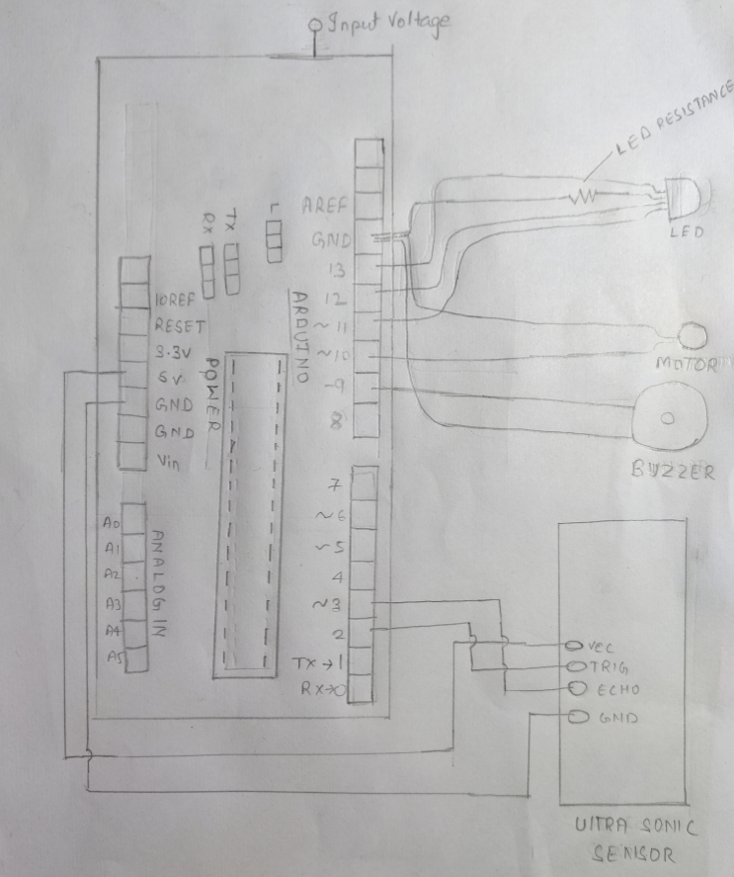
USE CASE DIAGRAM:

Slide 7
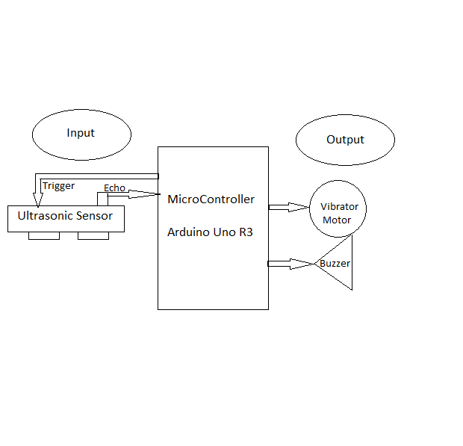
FLOW CHART OF SYSTEM

Slide 8
HOW IT WORKS?
Smart Gloves is basically used to determine objects nearby for blind people. It's working procedure is very simple, and is described below-
1.First the gloves determine the object's distance using the sensors attached.
2.Sensor measures the range of the object and accordingly sends the signal to the microcontroller ( here we used Arduino).
3. If the distance of the obstacle is greater or equal to 95cm it will be marked as safe, and the led’s output will be green.
If the distance is less than 65cm and greater or equal to 45cm ,the glove will identify it as close and start the buzzer.
If the distance is less than 45cm, the glove will identify it as very close(unsafe distance) and give the output led red colour and start both the buzzer and vibrator to alert the user.

Slide 9
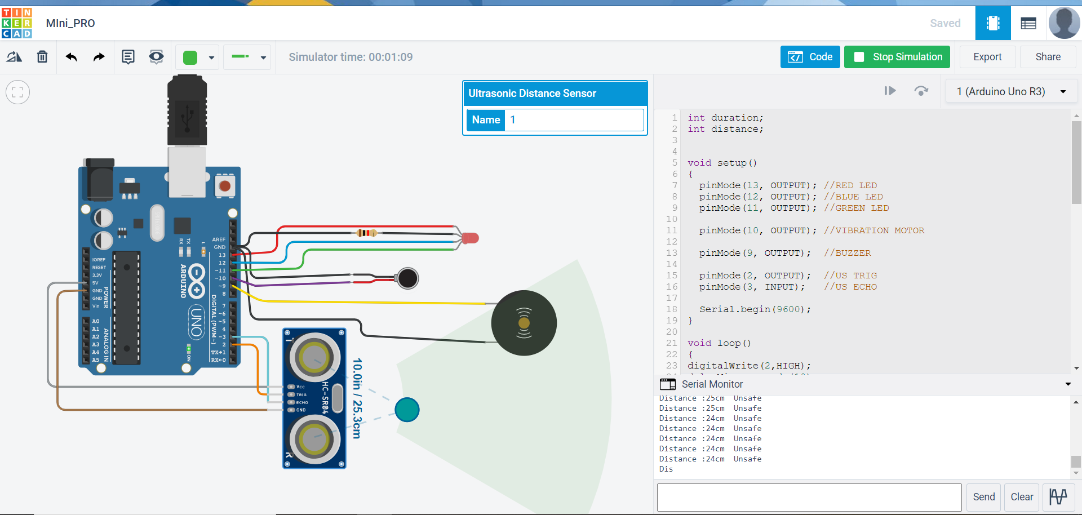
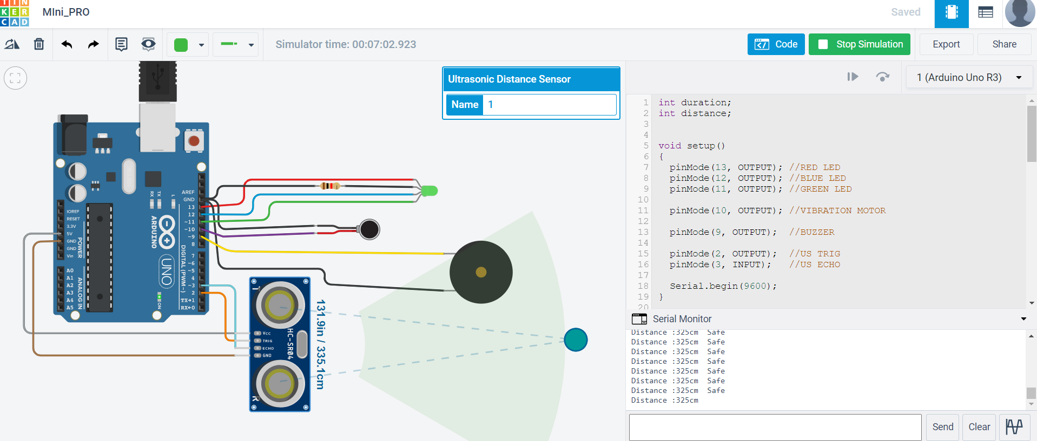
UNSAFE:
SAFE:

Slide 10
LIMITATION:
This project only used for blind people, who get affected in their daily life problems. Limitations of this project is that it only notifies with buzzer and vibration by device and one more features that if the particular person/obstacles image identity is saved in the system the camera will identify the things otherwise not it can only notify by buzzer and vibration only.

Slide 11
CONCLUSION:
The main purpose of this study is to produce a prototype that can detect objects or obstacles in front of users and feeds warning back, in the form of vibration, to users.
Combination of ultrasonic sensor and a microcontroller function for detection and distance stick and obstacles in front of.
This project is to people with disabilities that are blind to facilitate the movement and increase safety.

Slide 12
ACKNOWLEDGEMENT:
First and foremost, we would like to thank our Professor Dr. Samik Marick who guided us in doing these project. He provided us with invaluable advice and helped us in difficult periods. His motivation and help contributed tremendously to the successful completion of the project.
Besides, we would like to thank all the teachers who helped us by giving advice and providing the equipment which we needed the most.
Also we would like to thank our family and friends for their support. Without that support we couldn’t have succeeded in completing this project.
At last but not in least, we would like to thank everyone who helped and motivated us to work on this project.

Slide 13
THANK YOU.
N

